Slide 1

Working with Men in Psychotherapy
Dr. John Ogrodniczuk
Professor & Director, Psychotherapy Program
Department of Psychiatry, UBC

Slide 2

Help Seeking among Men
HEADSUPGUYS.ORG
info@HeadsUpGuys.org

Slide 3
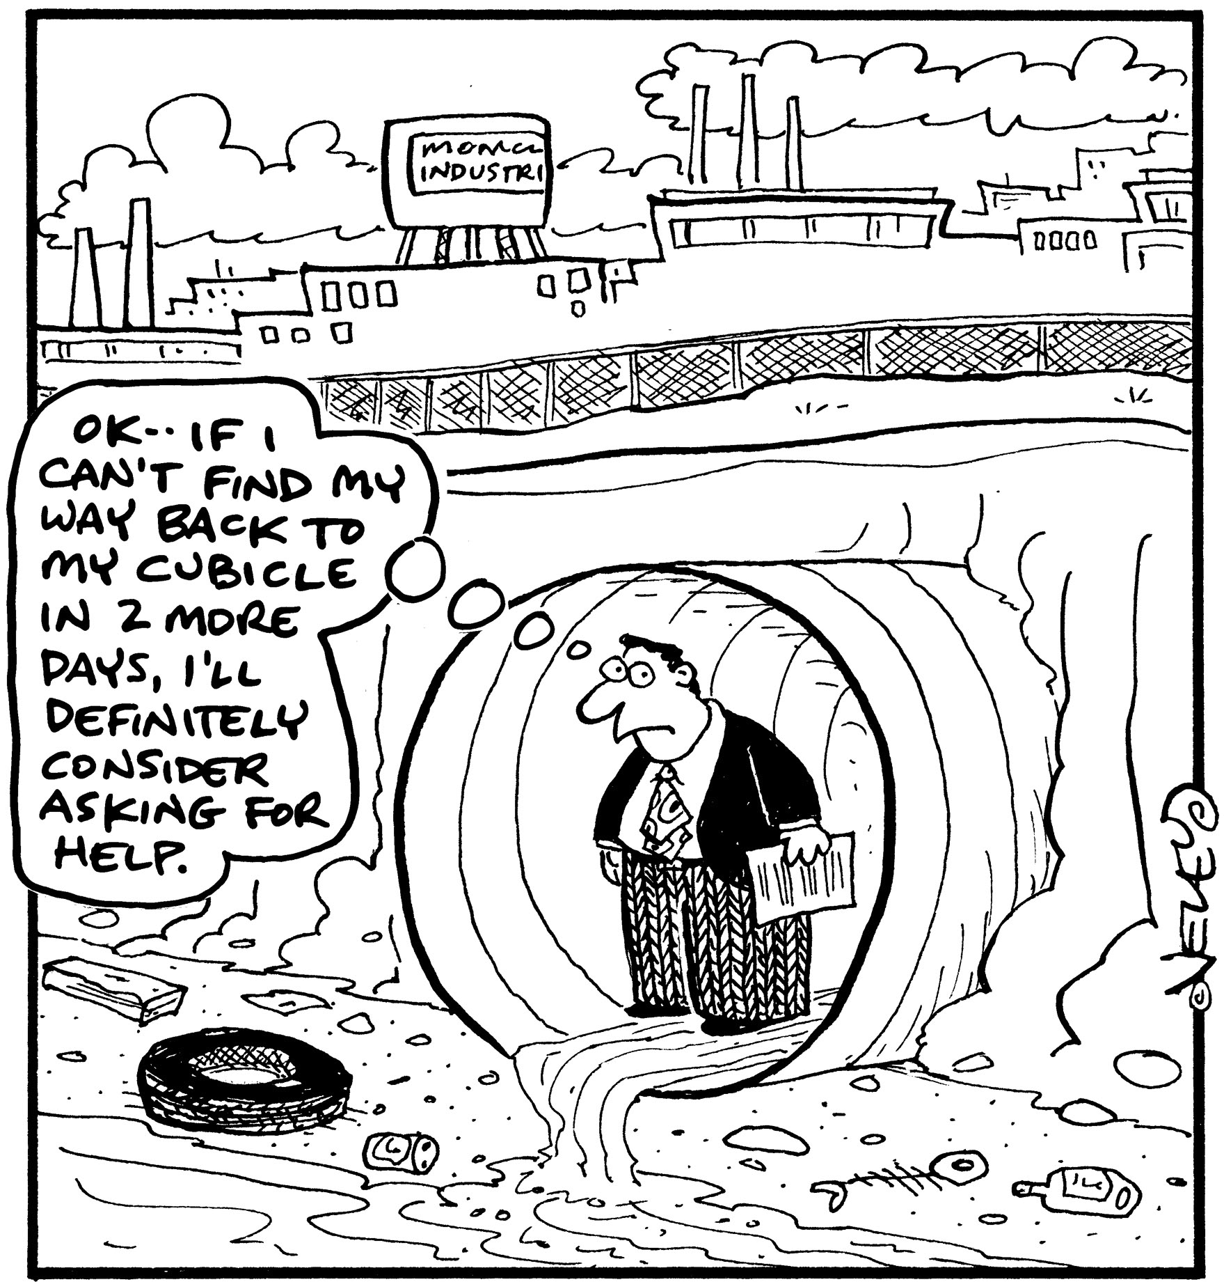
Men’s Help Seeking
HEADSUPGUYS.ORG
info@HeadsUpGuys.org

Slide 4
Reluctance to Seek Help
Growing literature documenting low rates of help-seeking among men in many different contexts. (Vogel & Heath, 2016)
Psychological help-seeking among men is particularly low. (Sagar-Ouriaghli et al., 2019)
  And it’s not because men are more psychologically healthy.
  Will often delay seeking help until there is a crisis.
HEADSUPGUYS.ORG
info@HeadsUpGuys.org

Slide 5
Masculinity & Help Seeking
Masculine socialisation
  Society’s “teachings” about how to be a man.
  “Norms” around what men do and don’t.
Do’s
  Independent
  Self-reliant
  Tough
  In control of emotions
Don’ts
  Show emotions
  Expose vulnerabilities
  Rely on others
  Ask for help
HEADSUPGUYS.ORG
info@HeadsUpGuys.org
Notes:
Put more simply, these masculine norms can inform males of what men do and don’t do, and it’s clear how this can have an impact on help seeking.

Slide 6
Constrictive Masculine Norms
Control your emotions
Boys don’t cry, Suck it up, Push it down
Distance from emotions
Lose touch with one’s feelings (what they are, what they mean)
Impaired emotion regulation
Recognition and management of distress are impeded
HEADSUPGUYS.ORG
info@HeadsUpGuys.org

Slide 7
Self-Reliance
Self-reliance related to low help-seeking intentions.
  Study of 14,000 men found that self-reliance was the strongest risk factor for suicidal thinking.
Men who are overly self-reliant:
  believe that they should be strong in the face of any adversity,
  consider that feeling down is a sign of weakness,
  are unlikely to reach out to friends, family or professional sources for help.
McDermott et al. 2018
Pirkis et al. 2017
HEADSUPGUYS.ORG
info@HeadsUpGuys.org
Notes:
Ultimately, an entrenched sense of self-reliance can have fatal consequences.

Slide 8
Distress Concealment
Distress concealment associated with:
  lower likelihood of help-seeking
  more severe symptoms of depression
    Effect on depression mediated by ‘not feeling understood’ and loneliness.
      Exposes the conflict between adherence to masculine norms and what men actually want/need.
Rice et al., 2020
Cox et al., 2020
Keum et al., 2023
HEADSUPGUYS.ORG
info@HeadsUpGuys.org

Slide 9
Not good to do the “lone ranger” thing
Symptoms become more severe and chronic.
More intensive treatment regimens required.
  Ironically, greater sense of embarrassment when help is finally sought.
Increased cost to the public health system.
HEADSUPGUYS.ORG
info@HeadsUpGuys.org

Slide 10
A Terrible Consequence
Suicide is 3-4x higher among men. (World Health Organization, 2024)
Leading cause of death under the age of 50. (World Health Organization, 2024)
Some authors have starkly summarized the situation in this way: “women seek help-men die”. (Angst & Ernst, 1990)
HEADSUPGUYS.ORG
info@HeadsUpGuys.org

Slide 11
Mental health literacy
Men tend to have poor mental health literacy regarding depression and suicide. (Oliffe et al., 2016; Ratnayake & Hyde, 2019)
This includes low awareness of available mental health organisations and services. (Jorm, 2009; Morgan & Jorm, 2007)
Poor mental health literacy associated with more negative attitudes about and lower intentions to seek professional help. (Coppens et al., 2013; Rafal et al., 2018)
HEADSUPGUYS.ORG
info@HeadsUpGuys.org

Slide 12
Stigma
Men report high self-stigma regarding depression
  embarrassment about seeking help for depression (Oliffe et al., 2016)
Self-stigma hinders
  intentions to seek mental health and services information (Lannin et al., 2016)
  actual help-seeking among men (Mostoller & Mickelson, 2024)
HEADSUPGUYS.ORG
info@HeadsUpGuys.org
Notes:
Self-stigma: internalizing society’s negative attitudes and stereotypes about people with mental health problems.

Slide 13
Perceived Barriers
778 men with self-identified mental health problem and not currently receiving treatment
  ‘A lot of people feel sad and down’
  ‘I do not know what to look for in a psychotherapist’
  ‘I need to solve my own problems’
  ‘I cannot afford psychotherapy’
Items predictive of men not wanting treatment:
  ‘I would not tell my physician if I was feeling down or depressed’
  ‘I need to solve my own problems’
Seidler et al., 2020a
Notes:
Surveyed using a modified version of the barriers to mental health services scale.
On click: We also asked these men if they actually wanted to engage in treatment.

Slide 14
In their own words
What stops you from discussing your mental health with others?
Fear of implications toward life insurance coverage.
Don’t feel that I deserve help or compassion.
Social stigma.
Not used to talking about my inner feelings and fearful of loss of privacy.
Men are supposed to be strong and never need help.
HEADSUPGUYS.ORG
info@HeadsUpGuys.org
Notes:
Surveyed using a modified version of the barriers to mental health services scale.
On click: We also asked these men if they actually wanted to engage in treatment.

Slide 15
What gets them going?
Help seeking is more likely if he . . .
Perceives his problem as normal/common.
Sees the problem as “out of character”.
Believes that he can “return the favour”.
Believes that others will be supportive of his actions.
Doesn’t think asking for help means losing control.
(Addis & Mahalik, 2003)
(Sierra-Hernandez et al., 2014)
HEADSUPGUYS.ORG
info@HeadsUpGuys.org
Notes:
Surveyed using a modified version of the barriers to mental health services scale.
On click: We also asked these men if they actually wanted to engage in treatment.

Slide 16
Facilitators
471 men who self-reported currently experiencing a mental health concern and being actively engaged in treatment
  Positive attitude about seeking help
  Belief that professional support helps in recovery
  Familiarity with mental health symptoms
  Knowing how to access professional help
  Family or friend having sought help before
Seidler et al., 2020b

Slide 17
Getting Men to Take Action
Re-framing help-seeking
Focus on solutions
Cost-effective
Courageous
Takes strength
Team effort (and you’re the captain)
Changing our language
Tackle the problem
Team-up
Defeat depression
Fight stress
(Hammer & Vogel, 2010)

Slide 18
COMMON ISSUES ENCOUNTERED WITH MEN IN THERAPY
HEADSUPGUYS.ORG
info@HeadsUpGuys.org

Slide 19
It’s a “stress” thing . . .
Most men won’t come in and say they’re depressed or anxious.
Usually, they talk about “stress”.
“Stress” is a euphemism for “I got some $#*! going on that I’m having a little trouble dealing with.”
Often, they can isolate their stress to certain problems (anger), behaviours (drinking), or situations (relationship with wife).
HEADSUPGUYS.ORG
info@HeadsUpGuys.org

Slide 20
Common “stress” issues for men
“Stress”
Anger (workplace, home, road rage)
Substance use (booze, drugs)
Relationship problems
Problem behaviours (sex, internet, gambling)
Work performance issues (procrastination, sabotage, avoidance)
HEADSUPGUYS.ORG
info@HeadsUpGuys.org

Slide 21
Shame
“Being shamed by their peers, as well as parents, is how boys are taught to conform to male gender role norms.”
When a man fails to live up to internalized expectations of what a man should be, he can experience shame.
Men tend to manage shame through ineffective and self-destructive strategies.
Paradoxically increases feelings of inadequacy, leading to more isolation and lack of support.
(Shepard & Rabinowitz, 2013)
HEADSUPGUYS.ORG

Slide 22
Loneliness
Loneliness is a pervasive issue for men, often exacerbated by societal norms that discourage emotional intimacy and vulnerability.
Men are socialized to prioritize independence and self-reliance, which can limit their ability to form deep, meaningful connections.
Key factors contributing to loneliness:
Cultural norms: Men are often taught to avoid showing weakness, making it harder to reveal one’s intimate self.
Life transitions: Events like divorce, retirement, or the loss of friends due to relocation can disrupt social networks.
Emotional restraint: Many men struggle to express feelings, which hinders bonding.
Digital reliance: Increased reliance on technology for connection can exacerbate feelings of isolation.

Slide 23
Meaning/Purpose in Life
A sense of purpose or meaning in life is a cornerstone of mental health, providing direction, motivation, and resilience.
Many men, however, struggle with existential concerns, especially during life transitions or periods of perceived failure.
Societal expectations: Men are often evaluated based on career success, financial stability, or their role as providers. Failure to meet these expectations can lead to existential crises.
Disconnection from values: Men who have pursued externally defined goals may find themselves unfulfilled, disconnected from their core values (not knowing one’s core values is also an issue unto itself).
Disconnection from others: Human beings often find meaning through their relationships. The tendency of many men to have relationships that lack emotional depth leave them vulnerable to not only feeling alone, but also lacking meaning in life.

Slide 24
Loss and Grief
“Grief work is the core element in men’s work, because grief is the common denominator that ties men’s experiences together.” (Jolliff & Horne, 1996)
Loss prominent at many points throughout the lifespan.
  Starts with loss of maternal bond
  Concrete losses, e.g., job, health, relationship
  Symbolic losses, e.g., status or prestige with changes in employment
It’s not the losses, per se, but how men negotiate sadness and grief associated with loss.
(Ogrodniczuk & Oliffe, 2009)
HEADSUPGUYS.ORG
info@HeadsUpGuys.org

Slide 25
Difficulties with Emotions
One of the most far-reaching consequences of masculine socialization is a disconnection/lack of attunement that many men have with their inner emotional world.
Many men struggle with recognizing their emotions, communicating their affective experiences to others, and understanding the meaning that their feelings carry.
    When asked to identify their feelings, they often will try to logically deduce how they should feel.
Anger tends to be the one emotion that many men can readily recognize.
HEADSUPGUYS.ORG
info@HeadsUpGuys.org

Slide 26
Special considerations for men in Ukraine
The war that is being waged by Russia against Ukraine is creating a host of unique difficulties experienced by Ukrainian men.
Men who have fought in the war
  PTSD; moral injury (soul death); survivor’s guilt; physical injury
Men who fear being conscripted
  Anxiety, dread, identity conflict
Men who are not eligible to fight
  Inadequacy, guilt, secondary trauma
Men who are hiding from enlistment
  Fear, shame, ethical and moral conflicts
Men who are part of regular society
  Stress, anxiety, guilt, compassion fatigue

Slide 27
  WORKING WITH MEN IN THERAPY
HEADSUPGUYS.ORG
info@HeadsUpGuys.org

Slide 28
Are men really put off by therapy?
Lots of speculation that men dislike counselling/therapy – yet virtually no evidence for this.
Men indicate a preference for psychotherapy over medication or no treatment/wait and see; a preference pattern that does not differ significantly from that of women. (Kealy et al., 2021)
“New” approaches just for men aren’t needed.
  But how we engage with men in therapy might need some tweaking in order to help keep them more engaged.
HEADSUPGUYS.ORG
info@HeadsUpGuys.org

Slide 29
Therapeutic Considerations
For the most part, therapy/counselling with men is not fundamentally different than what you’re used to.
It comes down to:
Appreciating the effect that masculine socialization has on men (the act of help-seeking, emotion awareness and regulation, being in a “helping” relationship, intimacy & disclosure, problem-solving)
Being attuned to common issues that men experience
Using a slightly different “style”
HEADSUPGUYS.ORG
info@HeadsUpGuys.org

Slide 30
Some basic working principles
Core therapeutic principles such as empathy, acceptance, building hope are just as important when working with men.
Communicate respect and interest.
Never assume that you know a client just because he’s a guy– every man is unique, with a distinct personality and his own story.
Awareness of one’s own limitations and accept that we can’t help everyone who walks through our door, and that some partnerships just don’t work.

Slide 31
Getting Started
Getting the story.
  So, what brings you in? [often will involve discussion of “who”]
Try to connect with what brought him in.
  E.g., His wife told him to come but he didn’t want to come.
    Okay, you came. So therefore, you must want to preserve your marriage, and you probably want to figure out what you can do about it, right?
Try to start building the alliance with his motivation for being there. How can we build on it?
HEADSUPGUYS.ORG
info@HeadsUpGuys.org

Slide 32
Getting Started
Assess his goals and expectations.
  What do you hope to get out of this?
Make sure expectations are realistic.
  There aren’t any quick and easy fixes.
Make it clear that this is a partnership, but ultimately he’s in charge of making things happen.
  We’ll work on this stuff together, but in the end, you decide what changes you want to make.
HEADSUPGUYS.ORG
info@HeadsUpGuys.org

Slide 33
Address Masculine Stereotypes
Description: Examine social expectations of masculinity that may restrict how a man shapes his identity and limit his ability to engage authentically with others.
Why It’s Useful for Men: Men often struggle with therapy because authenticity (vulnerability) is seen as incompatible with traditional masculinity. Addressing constrictive masculine norms helps men see being authentic as a strength rather than a weakness.
Application:
  Encourage open discussions about social pressures.
  Explore moments when traditional masculine norms (e.g., stoicism, self-reliance) have conflicted with emotional needs.
  Reframe being real and authentic as reflecting a strong sense of self.
HEADSUPGUYS.ORG
info@HeadsUpGuys.org

Slide 34
The good side of masculinity
I focus on guys’ strengths and positive masculine attributes.
Provider
Courage
Loyal
Protector
Rationale
Responsible
HEADSUPGUYS.ORG
info@HeadsUpGuys.org

Slide 35
Pay attention to tone of voice
Avoid using a low-voiced, soft, emotion-evoking vocal tone.
  Particularly in the early phase
It’s too uncomfortable and threatening for a lot of guys.
Once a strong alliance/partnership is developed, then, on occasion, soften the tone of your voice when it’s time to dig deeper.
HEADSUPGUYS.ORG
info@HeadsUpGuys.org

Slide 36
Don’t be afraid to be direct
  Works with men’s action-orientated tendencies - “getting down to fixing stuff”.
  Helps instill confidence.
  Makes pauses and silence, when used, more effective.
  Helps men deal with their anxiety about actually coming for help.
  Mindful to not be pushy or controlling.
  Client is responsible for setting the agenda.
HEADSUPGUYS.ORG
info@HeadsUpGuys.org

Slide 37
Self-disclosure
Can be very useful in strengthening the partnership.
For men, it’s a sign of trust.
  More likely to experience the therapist/counsellor as a “real human being”.
Models openness.
Must be used judiciously – not over-done.
  Subtle is safer
HEADSUPGUYS.ORG
info@HeadsUpGuys.org

Slide 38
The use of metaphor
The use of metaphors in psychotherapy can be especially effective when working with men because metaphors provide an indirect, yet accessible way to explore emotions, experiences, and challenges.
Many men have been socialized to suppress or minimize emotional expression due to societal norms that equate vulnerability with weakness.
Metaphors can bypass these barriers by offering non-threatening, relatable, and creative ways to engage with sensitive or complex topics.
HEADSUPGUYS.ORG
info@HeadsUpGuys.org

Slide 39
On the topic of feelings . . .
Many men perceive therapy as a place where they will be expected to become emotional, and they don’t feel ready/willing/equipped to do what they believe they will be asked to do.
I give a little introduction to masculine socialization:
  “Many men were raised in such a way that they felt it was really inappropriate to express emotions, especially the kind that might make them “look soft”. But the fact is, for you to fix these problems, you're going to have to learn a lot more about your emotions. Think of your emotions as data – they tell you something about yourself. The more you understand your feelings (in other words, the data they carry), the more you understand yourself. The good news is that by working together, it’s totally do-able, and you’ll be stronger for it.”

Slide 40
Normalize Emotion Expression
Description: Help clients recognize that feeling and expressing emotions are a normal and healthy aspect of human experience.
Why It’s Useful for Men: Masculine norms teach men to suppress emotions, leading to difficulties in emotional awareness and expression. Normalizing these feelings reduces shame and builds emotional intelligence (framed as a new skill-set).
Application:
  Use psychoeducation to explain how emotions function and their role in well-being.
  Careful use of silence can give men the space to feel.
  Reinforce and validate when men share their feelings, even in small increments.
HEADSUPGUYS.ORG
info@HeadsUpGuys.org

Slide 41
Working with emotionally constricted men
Putting into words the chain of events that makes up the difficult situation.
Making the client’s appraisal of the difficult situation explicit.
Addressing affective responses and discussing the client’s way of dealing with the difficult situation.
HEADSUPGUYS.ORG
info@HeadsUpGuys.org

Slide 42
Working with emotionally constricted men
1. Putting into words the chain of events that makes up the difficult situation.
Ask the client about his actual life and what goes wrong – creating a conversation.
Focus on concrete situations the client presents as important and difficult (trouble at home, incident with colleague).
Create an elementary narrative about the client’s difficulty.
HEADSUPGUYS.ORG
info@HeadsUpGuys.org

Slide 43
Working with emotionally constricted men
2. Make the client’s appraisal of the difficult situation explicit.
Start helping the client articulate what is painful or touching about the event.
Aim is to provoke normative reflection about the difficult situation (what is wrong about the situation, and why).
Attention shifts from the factual chain of events to the client’s subjective evaluations and reactions.
HEADSUPGUYS.ORG
info@HeadsUpGuys.org

Slide 44
Working with emotionally constricted men
3. Address affective responses and discuss the client’s way of dealing with the difficult situation.
Experiences of distress are addressed, with the aim of developing a narrative about them, and engendering reflection on how experiences of distress fit within the chain of events.
Therapist names and discusses these reactions as meaningful responses to the difficult situation.
Accounts of specific situations become integrated into a broader autobiographical account of events in life (building a life story).
HEADSUPGUYS.ORG
info@HeadsUpGuys.org

Slide 45
USEFUL STRATEGIES FOR WORKING
WITH MEN IN PSYCHOTHERAPY
HEADSUPGUYS.ORG
info@HeadsUpGuys.org

Slide 46
Being flexible and responsive
Having a consistent theoretical framework to approach psychotherapeutic work with a male client is important.
But this does not mean that one must rigidly adhere to techniques of one model.
In order to be optimally responsive to the needs of your client, you need to flexibly adapt and be able to integrate different therapeutic strategies that best serve the client’s needs.
Selection and utilization of different strategies are guided by the objectives of therapy and informed by the treatment framework.
HEADSUPGUYS.ORG
info@HeadsUpGuys.org

Slide 47
Emphasizing Personal Responsibility
Description: Encourages clients to recognize their role in shaping their experiences and responses.
Why It’s Useful for Men: This aligns with the cultural value many men place on agency and self-reliance, empowering them to take active steps toward growth.
Application:
  Use language shifts, such as replacing “I can’t” with “I choose not to” to foster accountability.
  Discuss how current behaviours or beliefs may perpetuate a sense of loss of control or helplessness.
  Frame personal responsibility as a strength, not a burden, to foster motivation for change.
HEADSUPGUYS.ORG
info@HeadsUpGuys.org

Slide 48
Building Awareness of Choice
Description: Emphasizes the power of choice and the ability to change patterns of thought or behaviour.
Why It’s Useful for Men: This empowers men to feel in control of their growth while challenging the helplessness they may experience.
Application:
  Highlight areas where the client feels stuck and explore choices they can make to move forward.
  Frame choice as an opportunity for empowerment rather than a sign of weakness.
HEADSUPGUYS.ORG
info@HeadsUpGuys.org

Slide 49
Here-and-Now Focus
Description: Emphasizes present-moment awareness, helping clients focus on their immediate thoughts, feelings, and bodily sensations.
Why It’s Useful for Men: Many men have been conditioned to avoid discussing emotions or past traumas. Focusing on the present allows them to explore feelings as they arise, reducing defensiveness.
Application:
  Encourage the client to notice and verbalize what they are experiencing in the moment (e.g., “What are you feeling in your body right now?”) to help them tune into their physical and emotional states.
HEADSUPGUYS.ORG
info@HeadsUpGuys.org

Slide 50
Body Awareness Techniques
Description: Intended to uncover emotions stored in the body or manifested through physical tension.
Why It’s Useful for Men: Some men may find it easier to access emotions through physical sensations rather than verbal exploration. Body awareness bridges this gap.
Application:
  Guide clients to focus on areas of tension, discomfort, or energy in their bodies.
  Ask exploratory questions like, “What might this tightness in your chest be trying to tell you?”
  Encourage movement or gestures to release or express blocked emotions.
HEADSUPGUYS.ORG
info@HeadsUpGuys.org

Slide 51
Empty Chair Technique
Description: Involves clients addressing an empty chair as though it represents a person, part of themselves, or a situation they need to confront.
Why It’s Useful for Men: Many men struggle with unresolved conflicts or repressed emotions toward others or themselves. The empty chair provides a safe way to externalize and process these feelings.
Application:
  Invite the client to express their thoughts and emotions to the person or part of themselves represented by the chair.
  Switch roles, having the client move to the chair to embody the perspective of the other person or part.
  Use this dialogue to uncover underlying emotions (e.g., shame, anger, grief) and facilitate resolution.
HEADSUPGUYS.ORG
info@HeadsUpGuys.org

Slide 52
Addressing Unfinished Business
Description: Focuses on resolving unresolved experiences that continue to impact the client’s present life.
Why It’s Useful for Men: Many men carry suppressed emotions from past experiences, such as childhood neglect or unmet expectations. Addressing these helps alleviate emotional weight.
Application:
  Encourage the client to identify unresolved relationships or situations.
  Use the empty chair or journaling to explore what remains unsaid or unprocessed.
  Help the client express forgiveness, anger, or grief to move toward closure.
HEADSUPGUYS.ORG
info@HeadsUpGuys.org

Slide 53
Working with Polarities
Description: This involves exploring opposing parts of the self, such as the “tough” and “vulnerable” sides, to achieve integration and balance.
Why It’s Useful for Men: Many men feel torn between societal expectations of masculinity and their authentic desires or emotions. This technique helps reconcile these inner conflicts.
Application:
  Identify the polarities at play (e.g., “the protector” vs. “the nurturer”).
  Facilitate a dialogue between these parts using the empty chair or guided visualization.
  Support the client in integrating these aspects, recognizing that both can co-exist harmoniously.
HEADSUPGUYS.ORG
info@HeadsUpGuys.org

Slide 54
Creative Expression
Description: Creative techniques like art, movement, or writing to help clients express emotions and develop insights.
Why It’s Useful for Men: For men who struggle with verbal expression, creative outlets provide a non-threatening way to explore emotions.
Application:
  Ask the client to draw or map their emotions or life challenges.
  Use movement exercises to embody and release emotions like anger or sadness.
  Encourage writing a letter to themselves or others (does not need to be sent).
HEADSUPGUYS.ORG
info@HeadsUpGuys.org

Slide 55
Incorporate Meaning-Making
Description: Facilitate discussions about purpose, values, and legacy.
Why It’s Useful for Men: Men often seek therapy when they feel a loss of direction or purpose. Addressing these existential concerns provides opportunities for reflection, self-awareness, and identity formation.
Application:
  Use open-ended questions to explore values and life goals (e.g., “What does success mean to you?” or “What legacy do you want to leave?”).
  A big part of meaning-making is helping clients learn to see the potential in difficult circumstances, develop resilient attitudes toward suffering, and contribute to others or to a larger cause.
  Encourage journaling or reflective exercises to deepen insights.
HEADSUPGUYS.ORG
info@HeadsUpGuys.org

Slide 56
Behavioural Activation
Description: Encourage engagement in activities to improve mood and counteract withdrawal.
Why It’s Useful for Men: Some men find action-orientated approaches more accessible than introspective ones. This method ties physical actions to psychological well-being.
Application:
  Keep a log to compare behaviours that make him feel good with the behaviours that make him feel bad.
  Identify one or two behaviours to increase and set a specific, achievable goal for practicing them more often.
  Throughout this process, keep track of how the behavioural changes affect feelings.
HEADSUPGUYS.ORG
info@HeadsUpGuys.org

Slide 57
Addressing Anger & Aggression
Description: Help men understand and manage anger or aggression by identifying triggers, understanding what underlies their anger, and engaging in alternative responses.
Why It’s Useful for Men: Men are often socialized to express distress through anger, which can lead to many other problems. Addressing anger and aggression fosters greater self-awareness and healthier coping mechanisms.
Application:
  Normalize anger as a valid emotion, while distinguishing it from aggressive behaviours.
  Explore underlying emotions, like fear or sadness, masked by anger.
  Teach relaxation techniques (e.g., deep breathing, mindfulness) and adaptive communication skills.
HEADSUPGUYS.ORG
info@HeadsUpGuys.org

Slide 58
Summary
In contrast to the common narrative that “men don’t do therapy”, many men are actually interested in therapy, and we are seeing more and more men engage in therapy.
Similarly, while it often espoused that some “special” approach to therapy with men is needed, in actuality, therapy with men is not fundamentally different than what you’re used to.
However, some special considerations about how to work with men can help keep them engaged in treatment, and hopefully extract maximum benefit.
As with any client, therapeutic flexibility is important, and in that sense, there may be certain strategies that could be particularly helpful for some men.
HEADSUPGUYS.ORG
info@HeadsUpGuys.org

Slide 59
What have you found helpful when working with men in psychotherapy?

